Slide 1

Booklet Assessment project
Eng : Rowayda Adel

Slide 2
Team Names
1- Ehab Tarek Ali Ahmed Fooz 2- Ahmed Mohamed Kamel
3- Ahmed Abdallah Gamil 4- Eslam Ashraf Mohamed 5- Eid Abe El Rehiem 6- Engy Essam Ahmed 7- Assma Ahmed Abdelale

Slide 3

Phases of Project
Data Acquisition
Data Cleaning
Data Pre-Processing
Text Representation
Build Model
Evaluate Model
Test Model

Slide 4
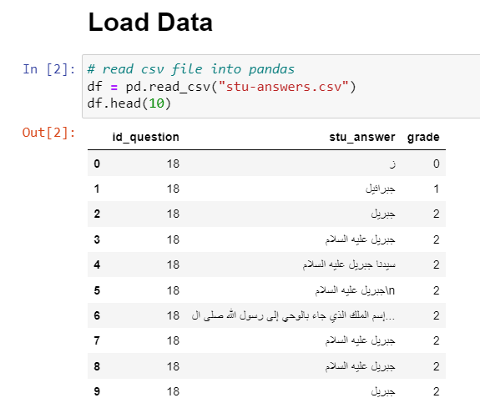
1. Data Acquisition
Get Data from Kaggle: arabic_answers | Kaggle

Slide 5
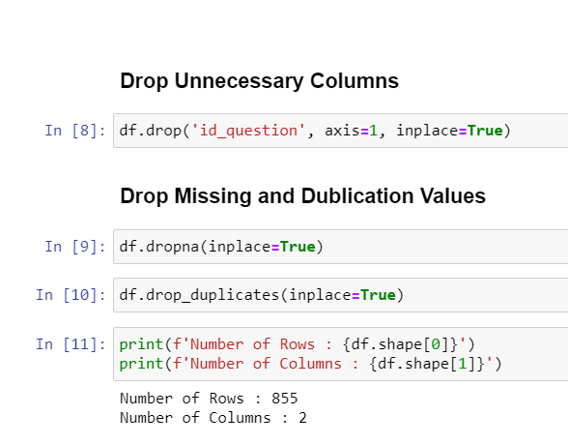
2. Data Cleaning
Drop unnecessary columns
Remove Missing values
Remove Duplication

Slide 6
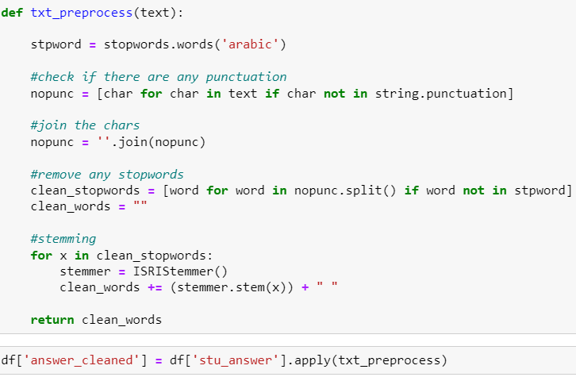
3. Data Pre-Processing
Word Tokenization
Stop Words Removal
Removing Punctuations
Stemming

Slide 7
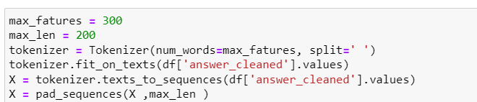
4. Text Representation
Apply Embedding Words.

Slide 8
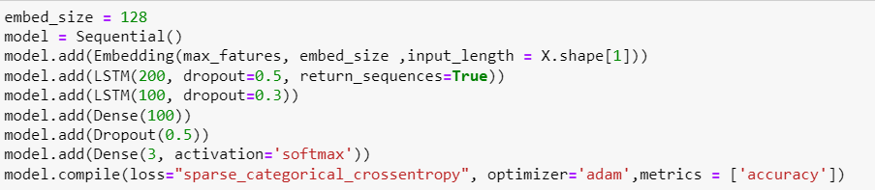
5. Build Model
By using Long Short-Term Memory (LSTM).

Slide 9

6. Evaluate Model
Evaluate model to be used or improve it.

Slide 10
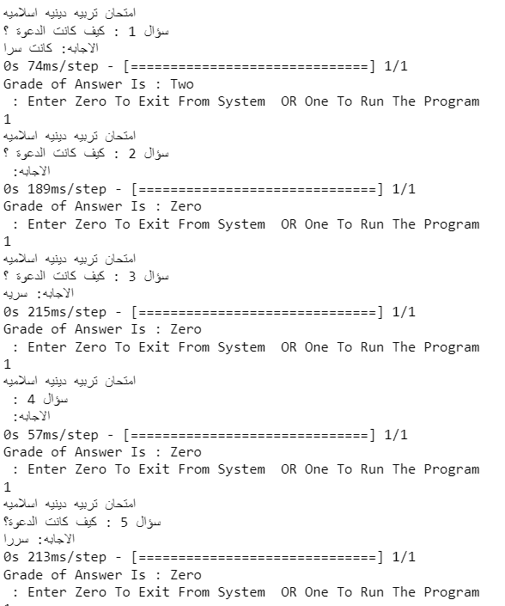
7. Test Model
Implement Program to test model which ask some questions and get student’s grades based on their answer.

Slide 11
Thank You

